Slide 1

Project Blink
Proof of Choice - 2.0 Introduction

Slide 2
What is Proof of Choice
Base Layer of Tri-Consensus Layer
Modified Delegated Proof of Stake which brings decentralized pool-less retail non-cutodial staking system
Blocks are staked individually instead of fixed deposit
Brings Non-Native transaction fees possible. Users can pay in transaction token
Brings Independant throughput (tps) per token
Brings Monetary Policy and Slash rewards

Slide 3
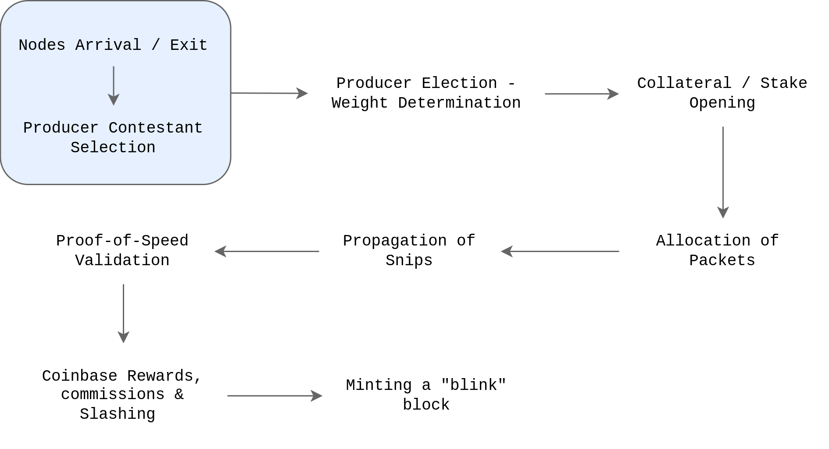

Slide 4
Next : 2.1 Producers Arrival

